Slide 1

CAMPUS CONNECT
A NEXT GENERATION SMART CAMPUS

Slide 2
Batch No: 23 Guide Name: Prof. A R Bindiya
Project Title: Campus Connect - A next generation smart campus
USN | Student Name
01JST19CS044 | Devothama G N
01JST19CS128 | Shaman B H
01JST19CS034 | Chandana Raju
01JST19CS042 | Darshan M

Slide 3
Contents
1. Introduction
2. Literature Review
3. Limitations of present work
4. Objectives of our work
5. Methodology
6. Work Plan
7. Conclusion

Slide 4
INTRODUCTION
01

Slide 5
The phrase "smart campus" refers to academic institutions that seamlessly integrate next-generation technologies into their infrastructure.
It increases more active interactions to encourage successful outcomes as today’s students are digital natives.
It allows for the creation of a "digitally connected" institution that can improve the on-campus experience, boost operational effectiveness, and deliver education that anyone can access right away.

Slide 6
LITERATURE REVIEW
02

Slide 7
2. LITERATURE REVIEW
We have considered a few research papers that have been published in different timelines that have influenced our proposal on a large scale.
[01] ONLINE COLLEGE PORTAL SYSTEM-Tejaswini Chavan, Deb Dutta, Michelle Gomez and Alvino Vaz
Online College Portal system aims to improve the efficiency of college information management.
The administrator and students are two major functional requirements in the system. The Administrator will be given more access (enable/disable/ update) as compared to users. This paper assists in automating the existing manual system

Slide 8
[02] A Systematic review on Technologies and Applications in Smart Campus-YUCHEN ZHANG , CHRISTINE YIP, ERWAN LU AND ZHAO YANG DONG
This paper focuses on the systematic review of the technologies used in designing a smart campus that is mainly human-centered.
It records the important contemporary information and communication technologies and smart applications that can be used to make the campuses next generation smart.
[03] Creating student’s profile using blockchain technology-V. Juričić, M. Radošević and E. Fuzul
The most up to date university project is Blockcert, an open-source software developed by Media Lab at MIT university and the Learning Machine company

Slide 9
Blockert is currently based on Bitcoin blockchain, using unique identifiers to store the hash of a certificate, or to be more precisely bash of certificates.
This allows systems to store any kind of certificate or any kind of data to the blockchain because it is not storing document, but only its hash.
[04] Chatbot Development for Educational Institute-Dr.Vishwanath Karad
A College Enquiry Chatbot is developed using chatbot algorithm that is a python library that makes it easy to generate automated responses to a user's input.
This makes it easy for developers to create chat bots and automated conversations with the users. Some of the chatterbot tasks performed are Present some information and taking inputs

Slide 10
LIMITATIONS OF PRESENT WORK
03

Slide 11
The present approach does not seem user-friendly as all the features of the library, placement cell, and student login data to name a few, are not available on a single platform
The existing system is definitely vulnerable as its encryption standards are comparatively low and there is a high concern of infringement of privacy of the student information
The portal is frequently out of service. This makes it uncertain and non-reliable. The existing system does not foster any kind of virtual interaction among the students and faculty.

Slide 12
OBJECTIVES
04

Slide 13
Develop a culture of data creation and collection, analysis, application and availability.
Empowerment of interaction in productive ways among students, professors, other faculty, and the community by giving them the knowledge they need.
To create and maintain a digital campus —the next-generation campus that continually modernizes iteratively over time.

Slide 14
METHODOLOGY
05
Brief implementation of the project

Slide 15
5.1 BLOCKCHAIN SYSTEMS IN EDUCATION
As a very promising technology, blockchain has found high-quality applications in the field of education.
It will allow total independence of the students towards the institution and complete control over their data.
Data stored on the blockchain is permanently recorded and encrypted using cryptographic methods to ensure integrity, immutability through hash functions, and authenticity.
The most up-to-date university project is Blockcert, an open-source software that is currently based on the blockchain, using unique identifiers to store the hash of a certificate or to be the more precise bash of certificates. This allows systems to store any kind of certificate or any kind of data to the blockchain because it is not storing a document, but only its hash.

Slide 16
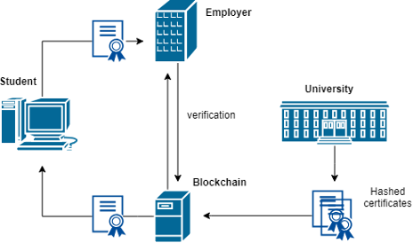
Components of a blockchain in an educational environment

Slide 17
5.2 SMART CONTRACTS
Smart contract is an executable program that is triggered when the system's state satisfies the contract's conditions or requirements.
Specifically, the diploma could be delivered to the student after the passing of all courses.
The smart contracts in education could be triggered after the fulfillment of all conditions required from the course, without any need for manual revision.
As an example, students would automatically receive a certificate upon acquiring a positive grade in the final exam, attending 80% of lectures and completing 25 exercises defined by the course.

Slide 18
WORKPLAN
06

Slide 19
Phase 1: Defining and analyzing the problem.
Phase 2: List all the requirements for the project.
Phase 3: Validating and Verifying all the requirements.
Phase 4: Creating the skeleton for our Web Interface and Login portal for students.
Phase 5: Creating web 3.0 and smart contracts creation using solidity.
Phase 6: Creating the module for the digital student profile system which runs on blockchain.
Phase 7: Creating the interface for the smart library.

Slide 20
Phase 8: Integrating all 3 modules and the Release of the first prototype.
Phase 9: Creating Club Zone interface.
Phase 10: Creating bots for various clubs by collecting information from clubs.
Phase 11: Integrating campus navigation module and placement portal of the college.
Phase 12: Creating a canteen module.
Phase 13: Final deployment.

Slide 21
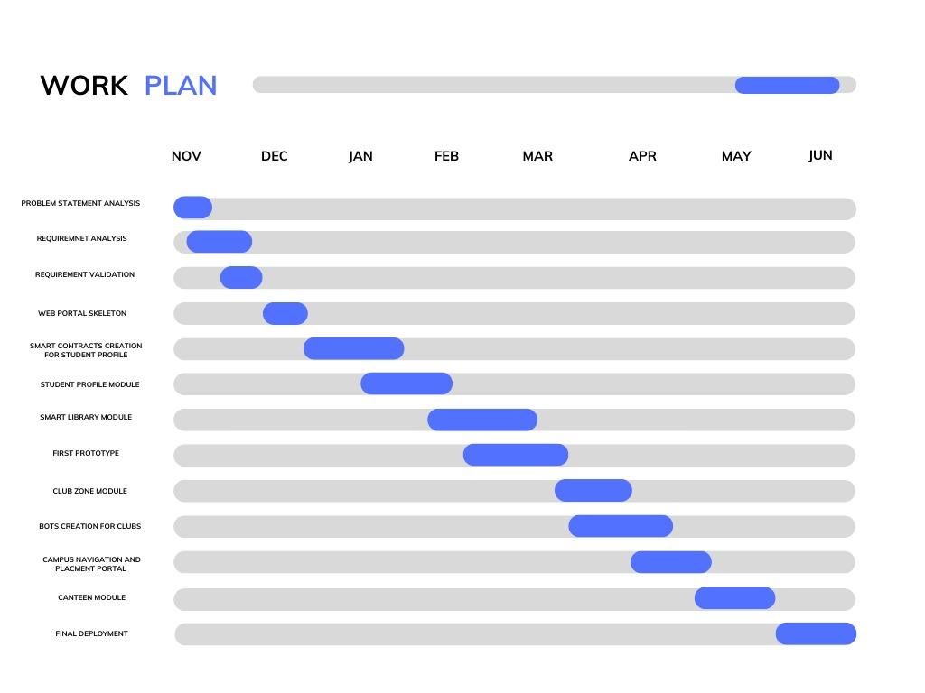

Slide 22
CONCLUSION
07

Slide 23
A smart campus can help improve three important factors: experience, efficiency, and education
It can help reshape how we interact on campus and it can be the proper way for the transformation that will enable campuses to address the future of learning and work while improving the campus experience
Our project mainly aims at digitizing crucial practices on the campus and also connecting all parts of the campus on a single portal where the availability of resources is of utmost concern.
Imagine if these technologies communicated in a manner that effortlessly initiated positive outcomes through intuitive and intelligent interactions.

Slide 24
Thank You!

